Slide 1
Making Paper in Senior Infants
November 2017

Slide 2
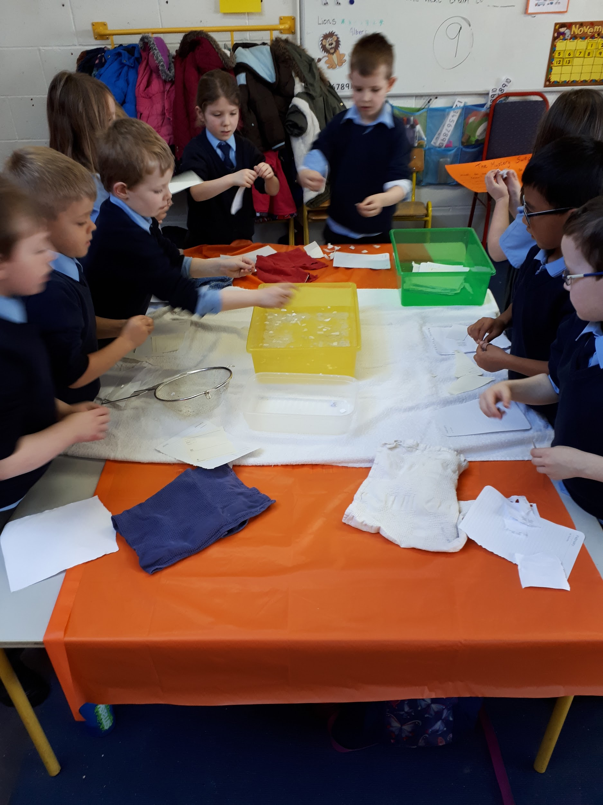
Making Mulch
Tear up used paper into small pieces
Put the paper pieces in the bath of water
Swirl the water to make sure the paper is thoroughly soaked

Slide 3
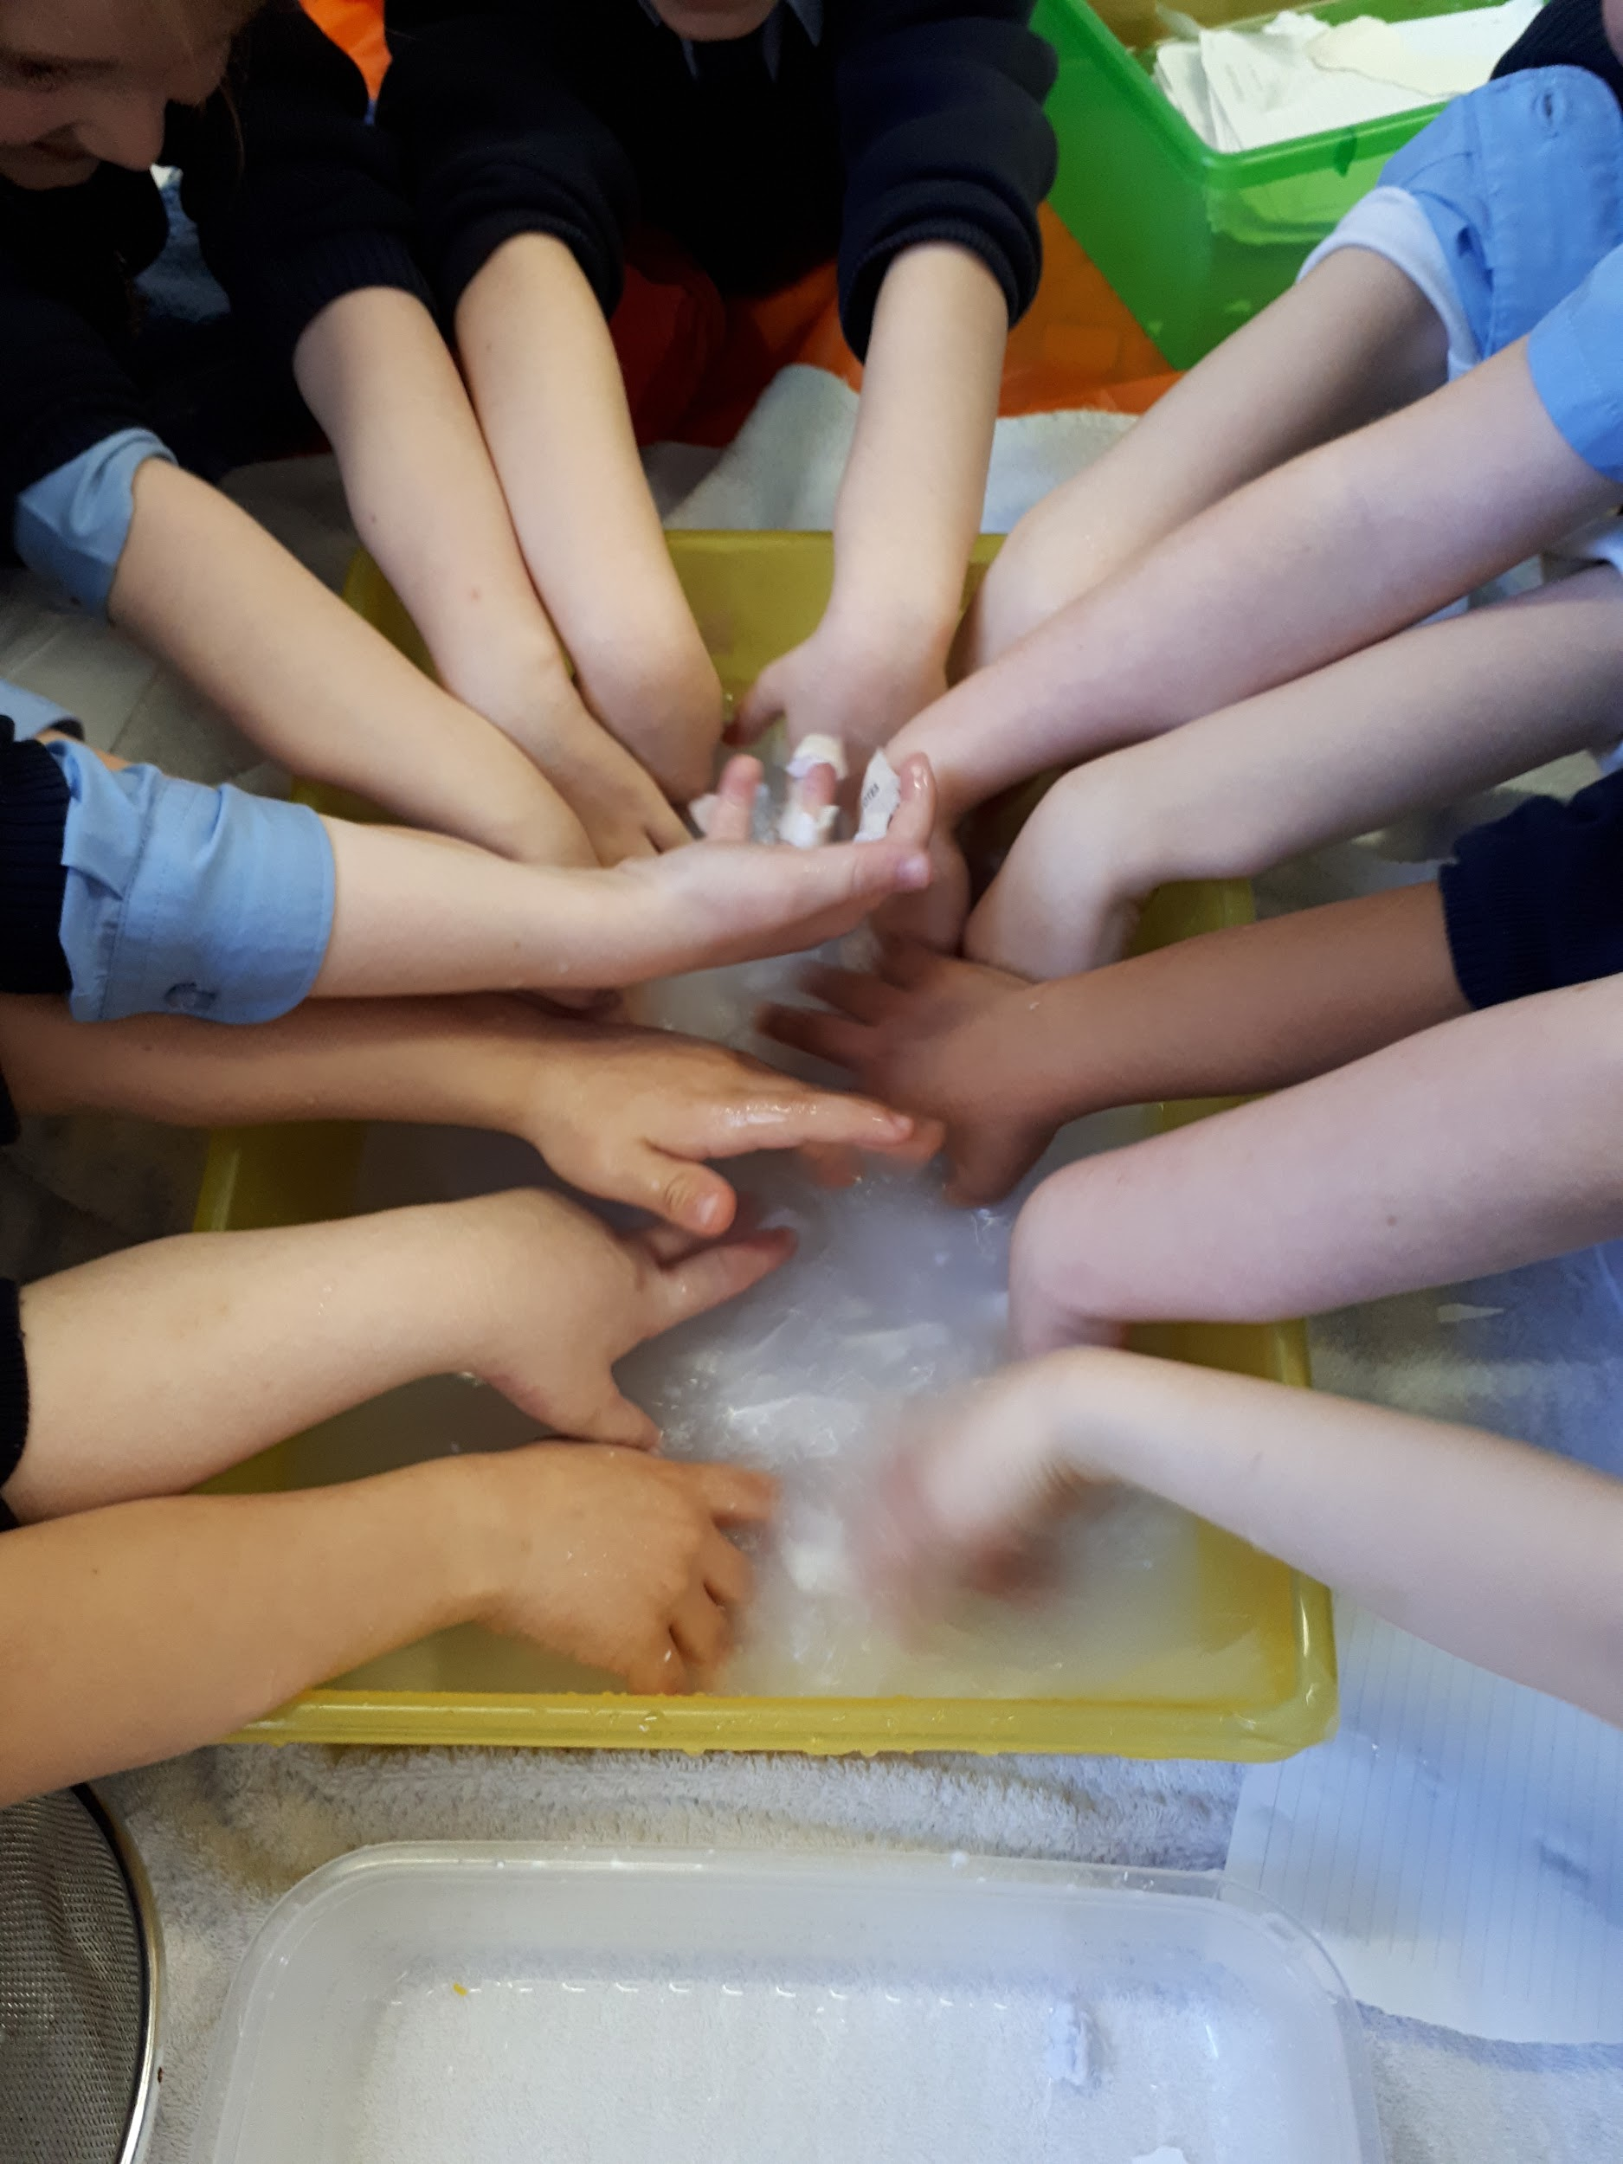
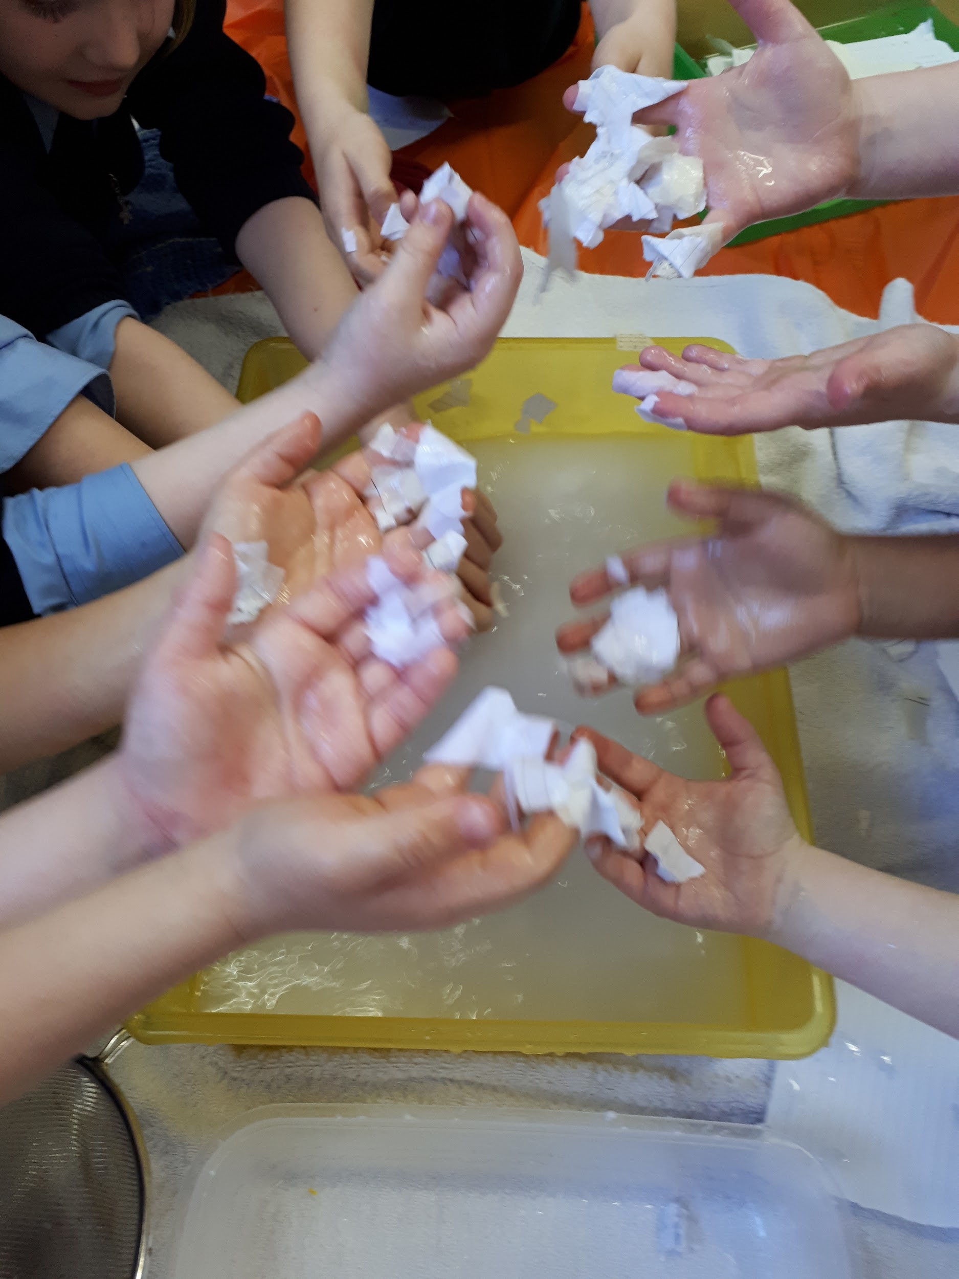
Squeeze a handful of paper to remove water

Slide 4
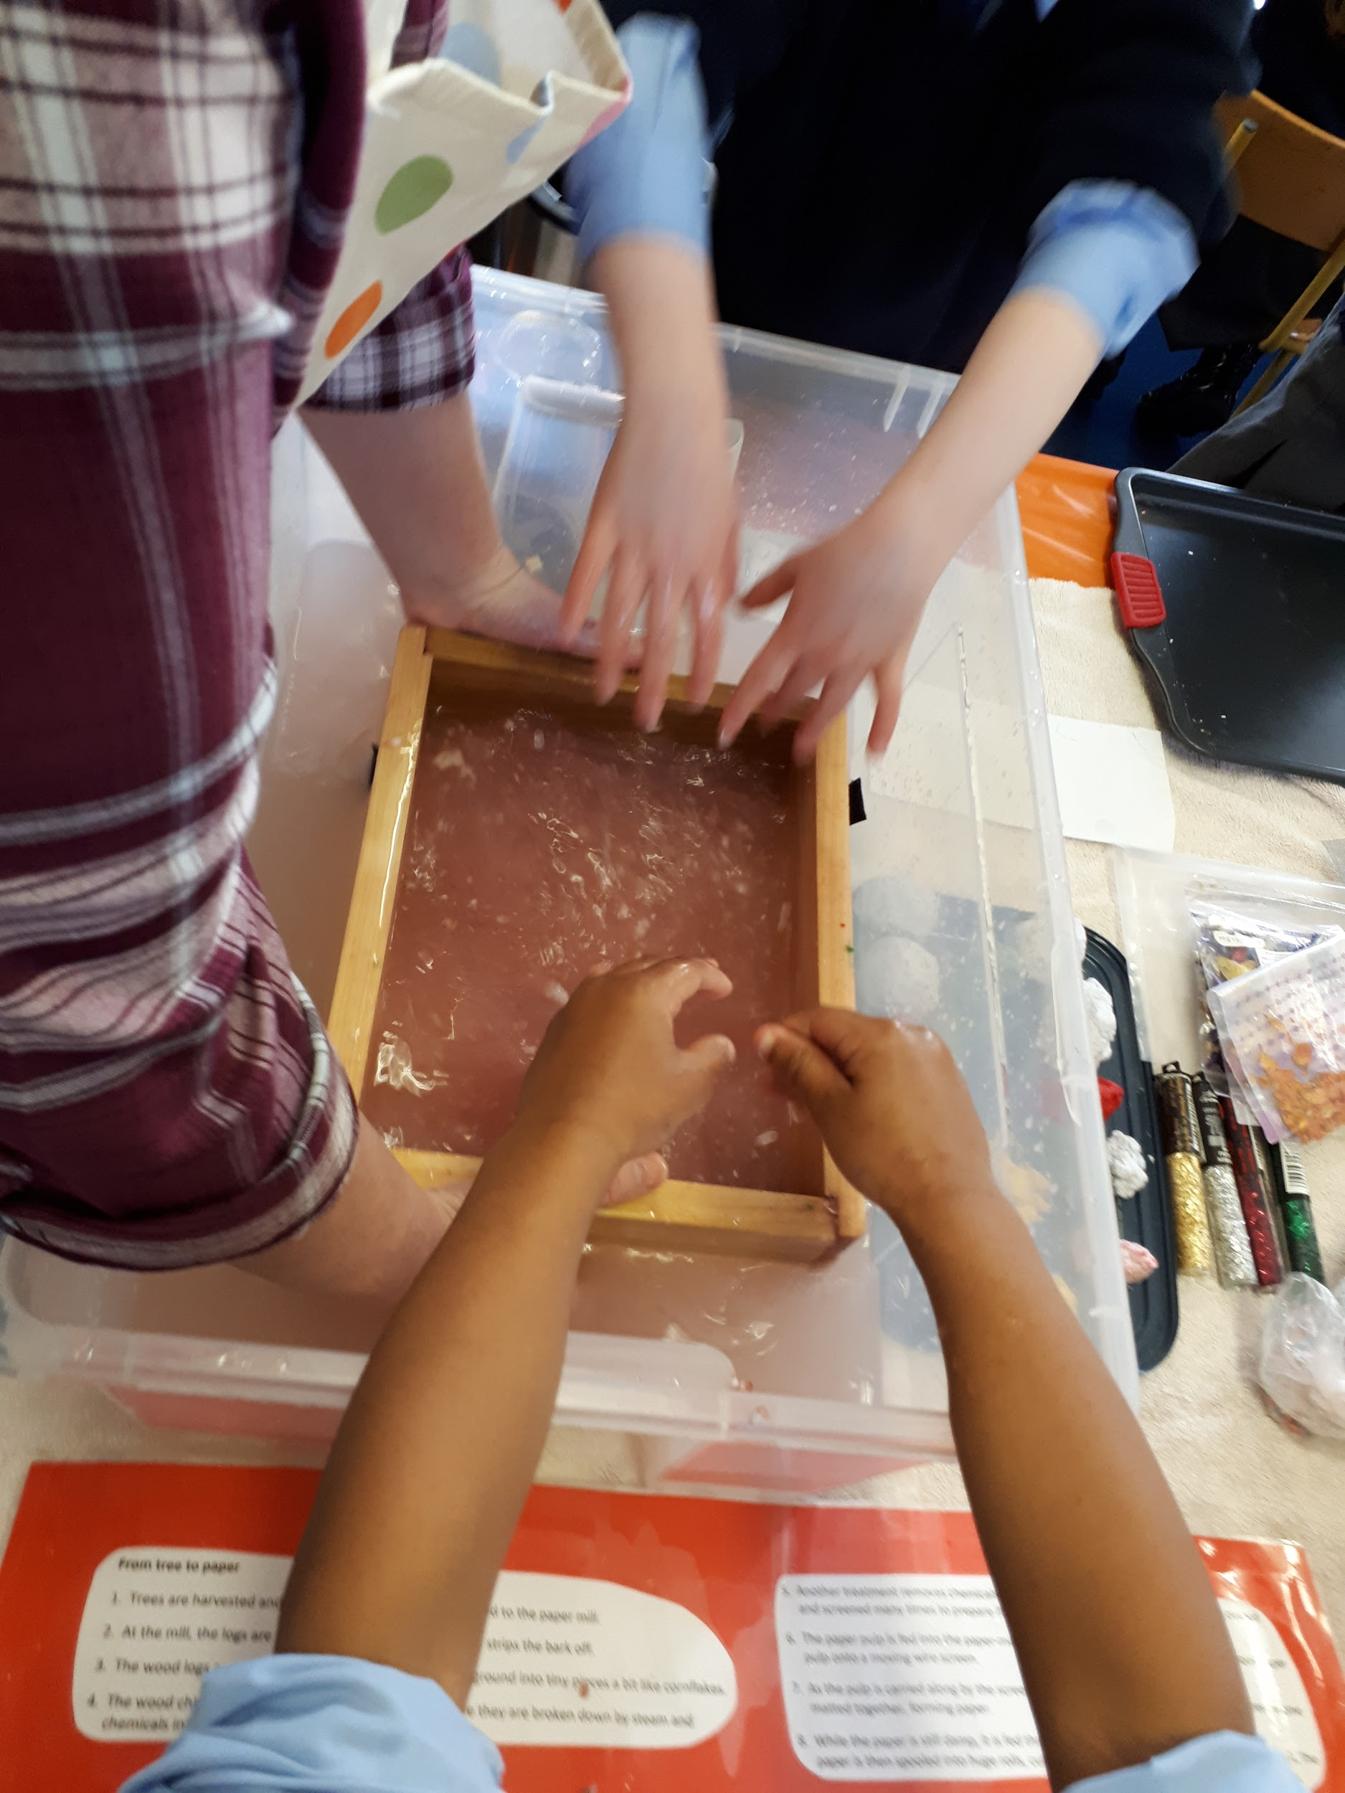
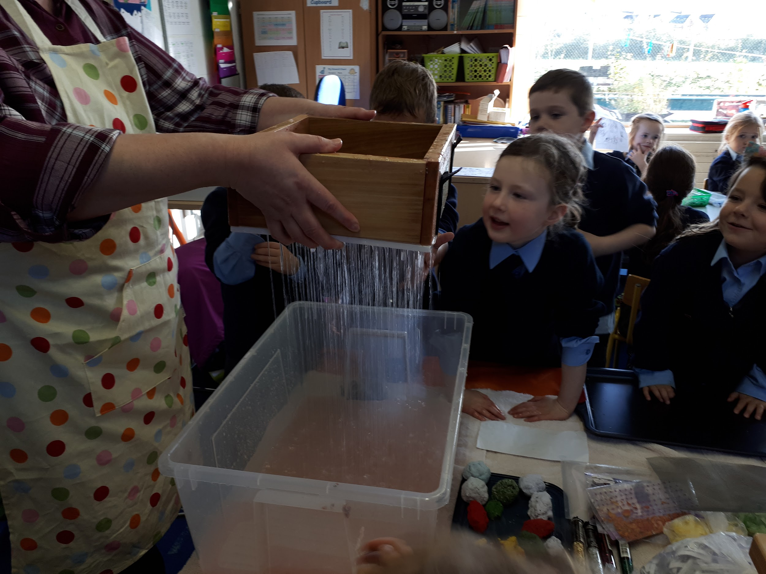
Rinse the mulched paper in a special sieve inside a water bath

Slide 5
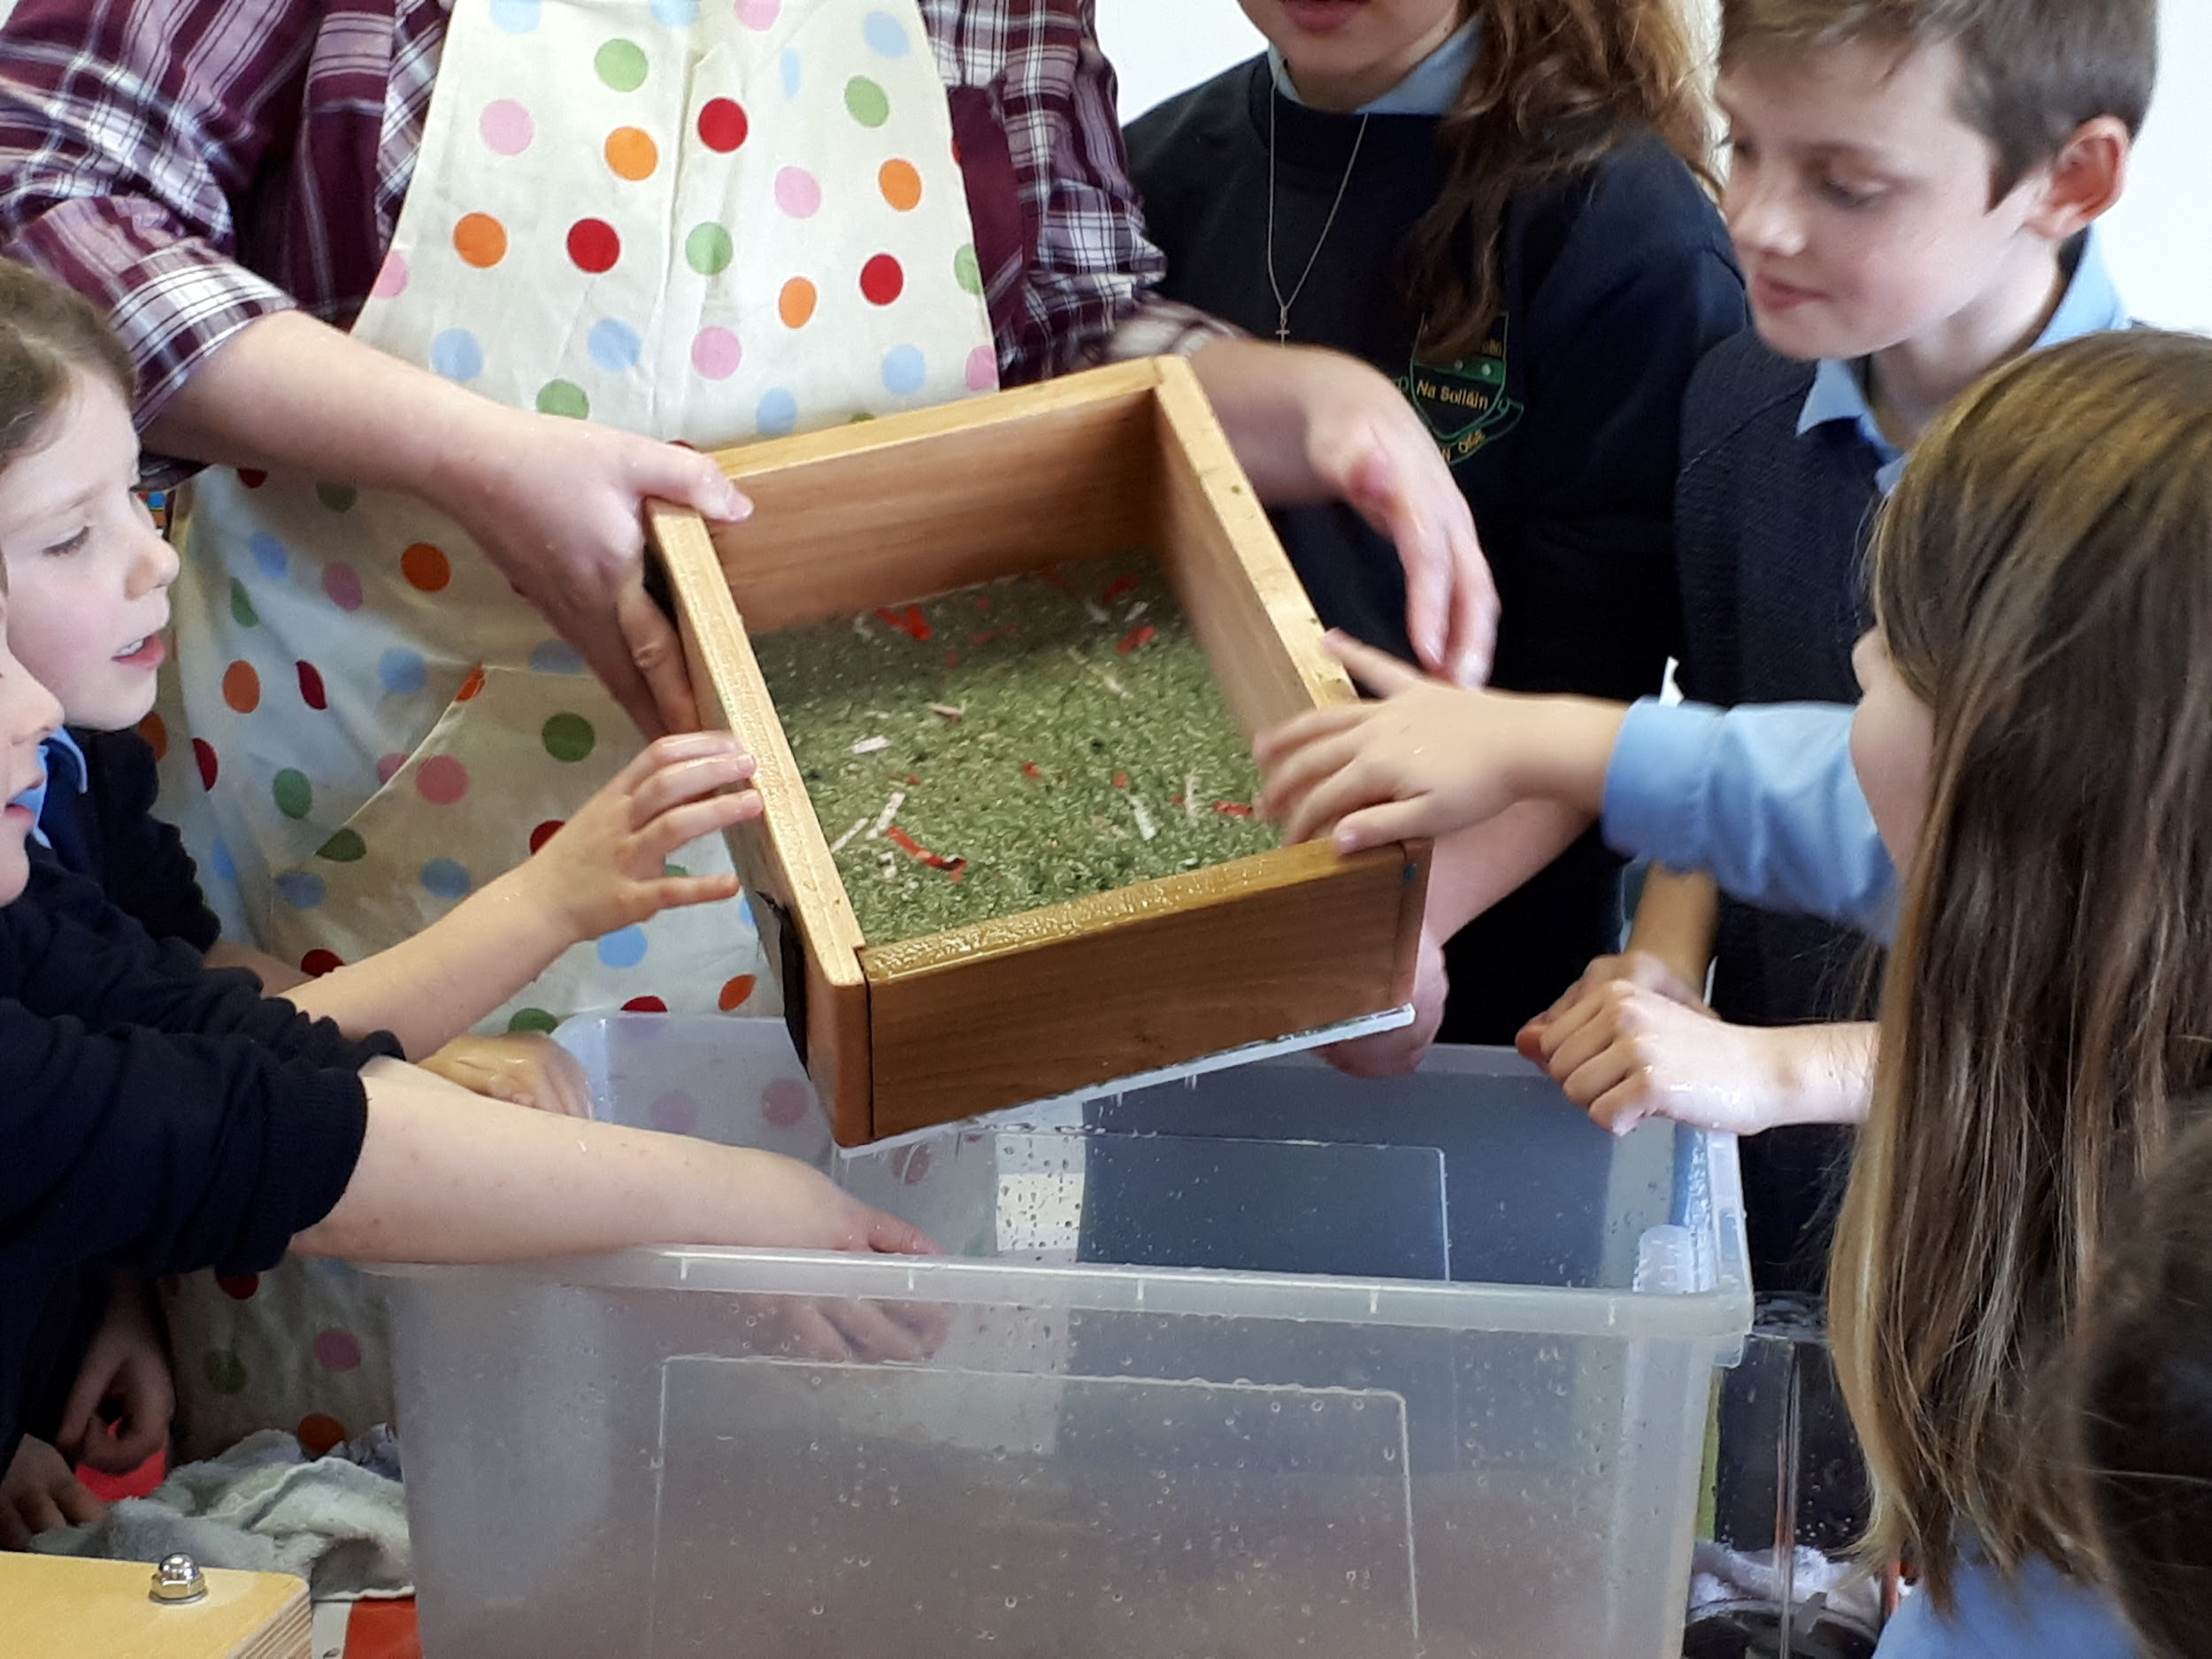
A thin sheet of munched paper is left on the sieve

Slide 6
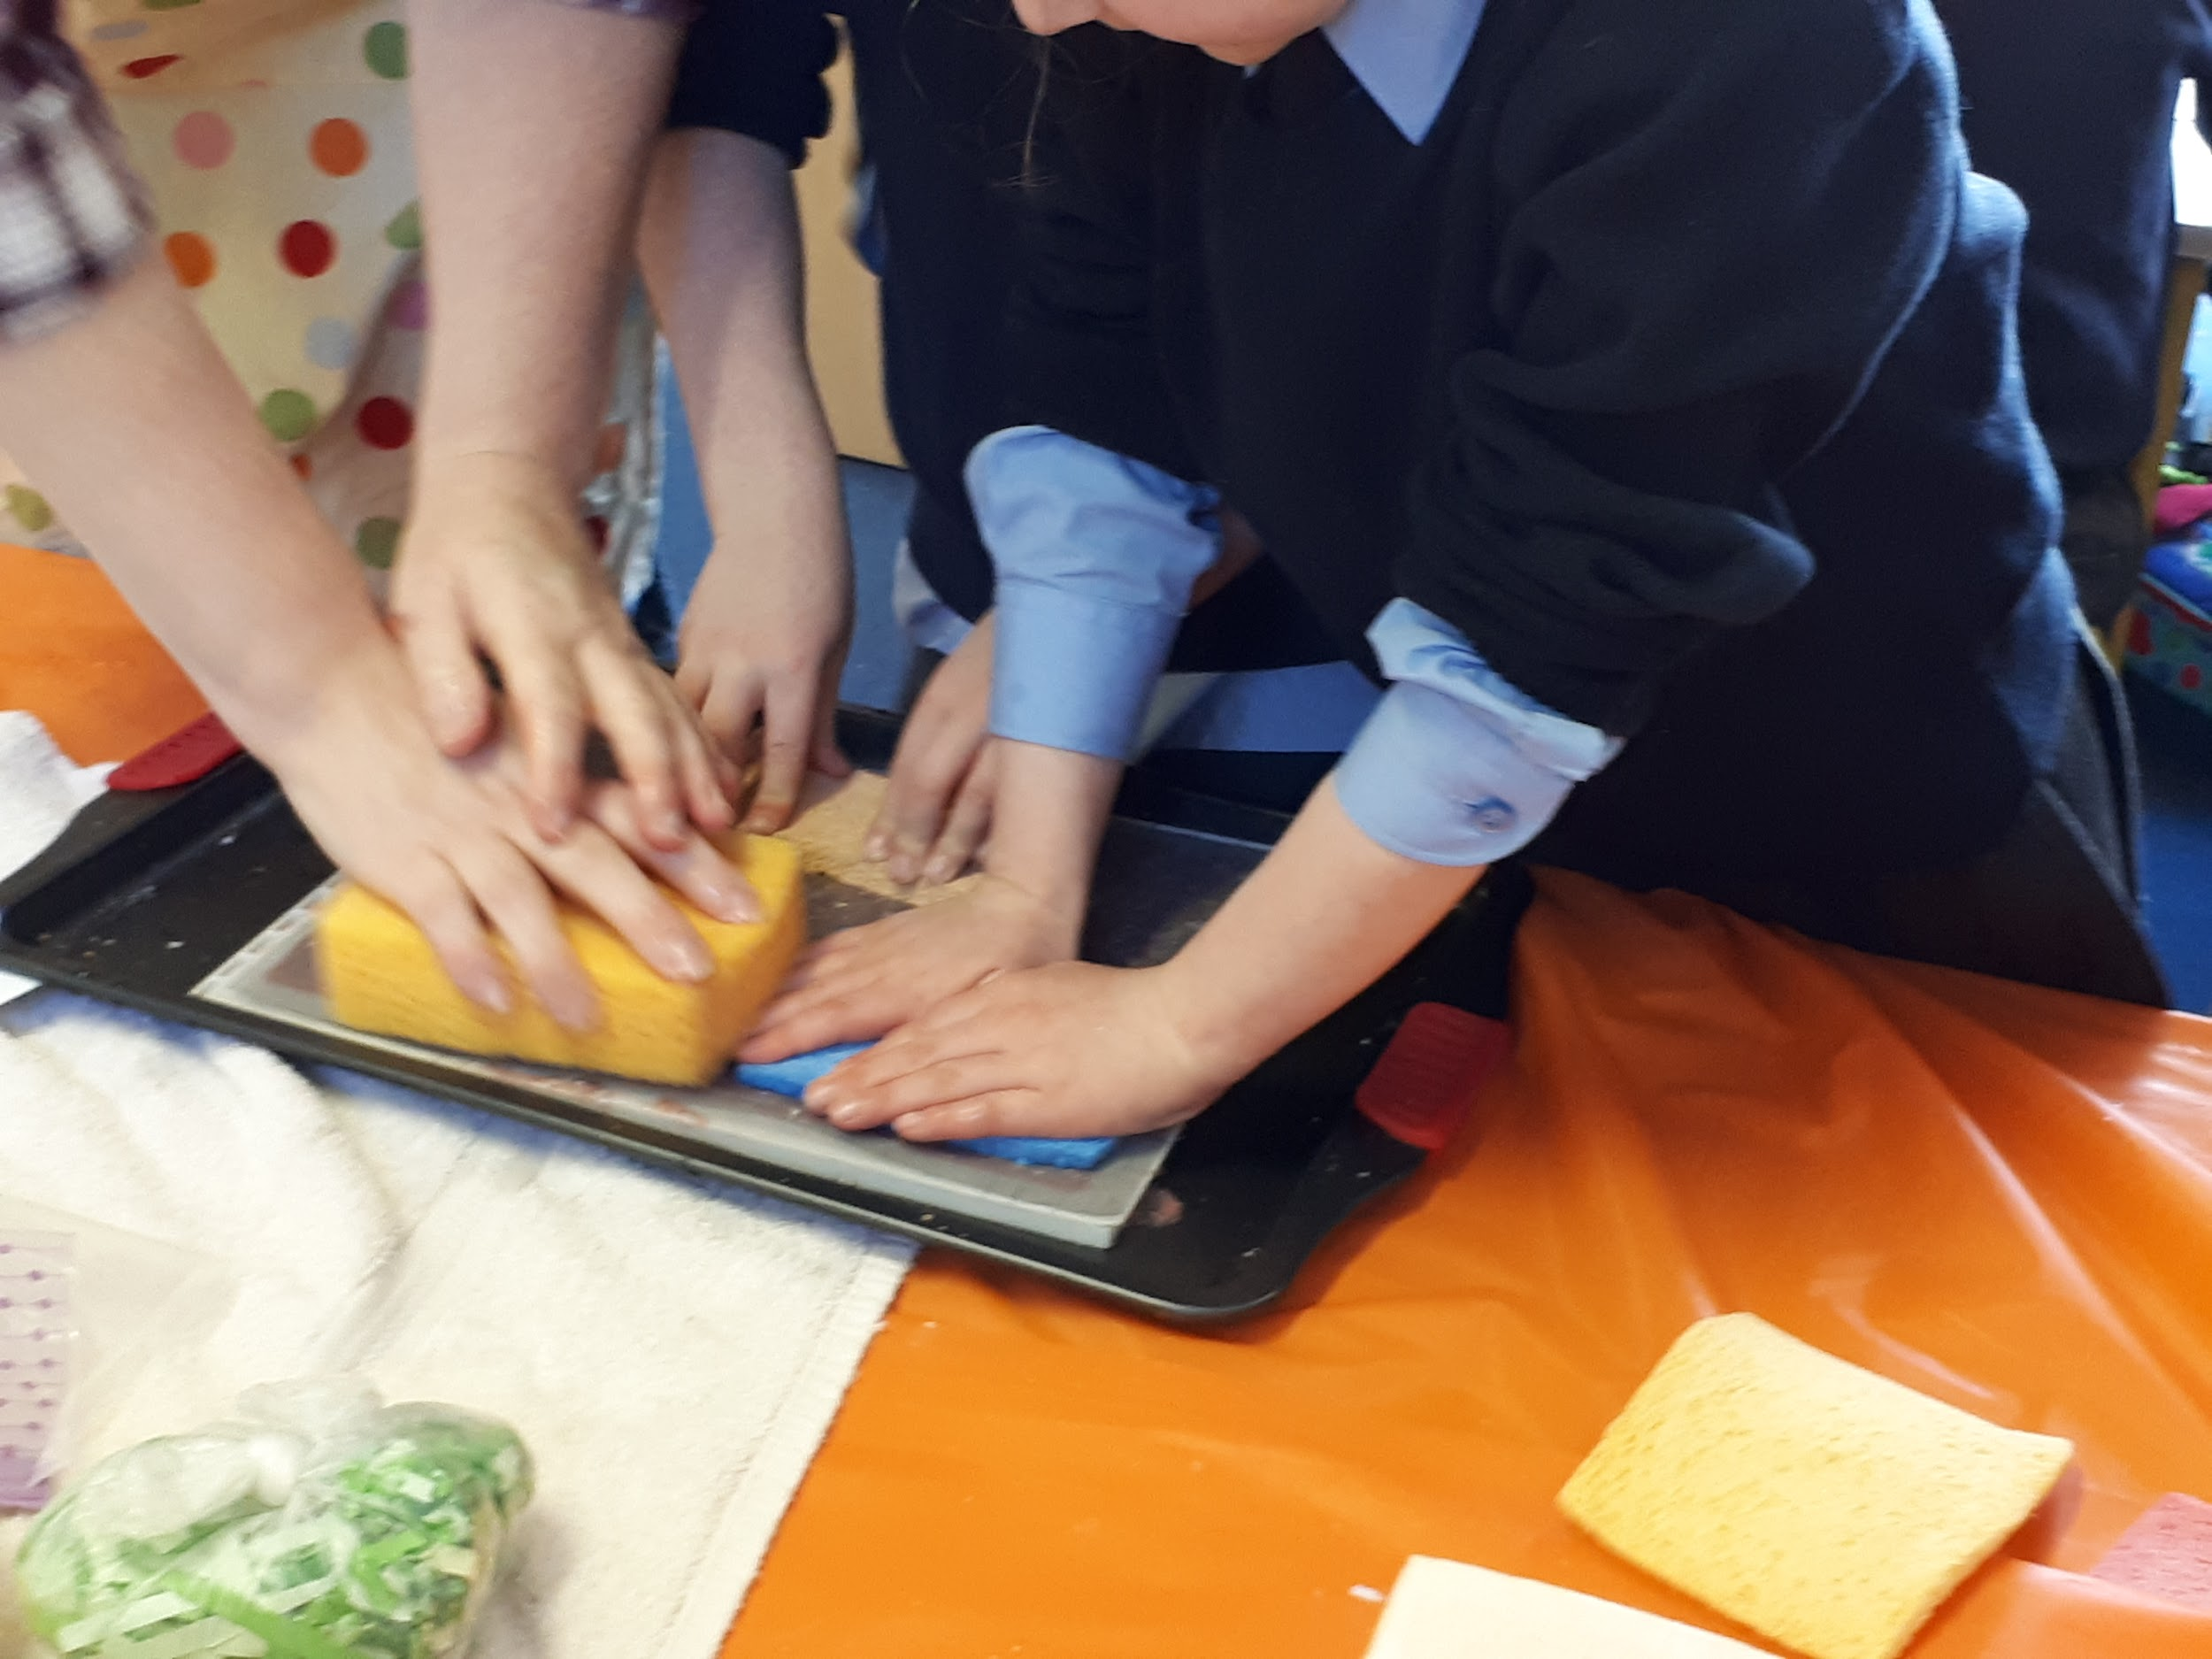
Sponge the sheet of wet paper to remove more water

Slide 7
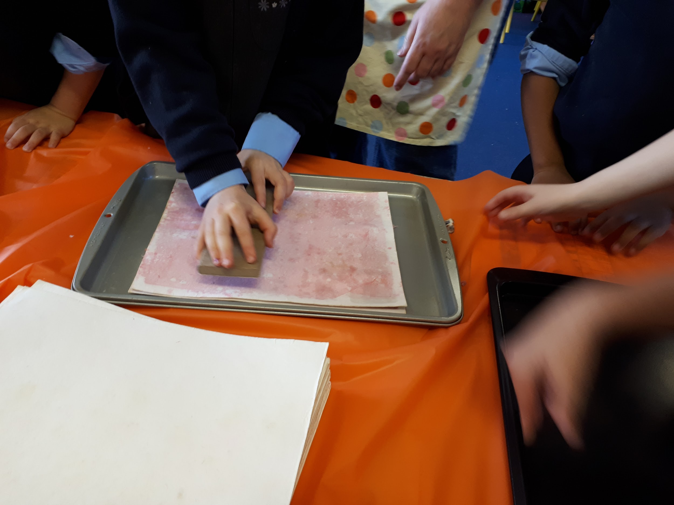
Use a wooden block to compress the munched paper sheet

Slide 8
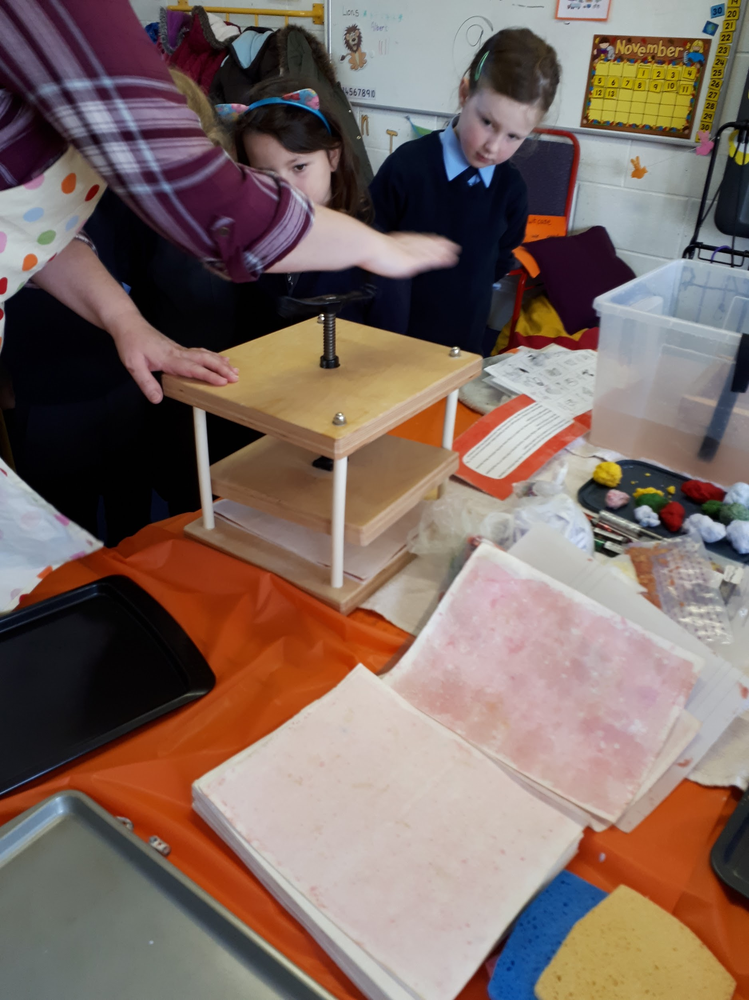
Place the sheet of munched paper into a vice.
Turn the handle to squeeze it tightly

Slide 9
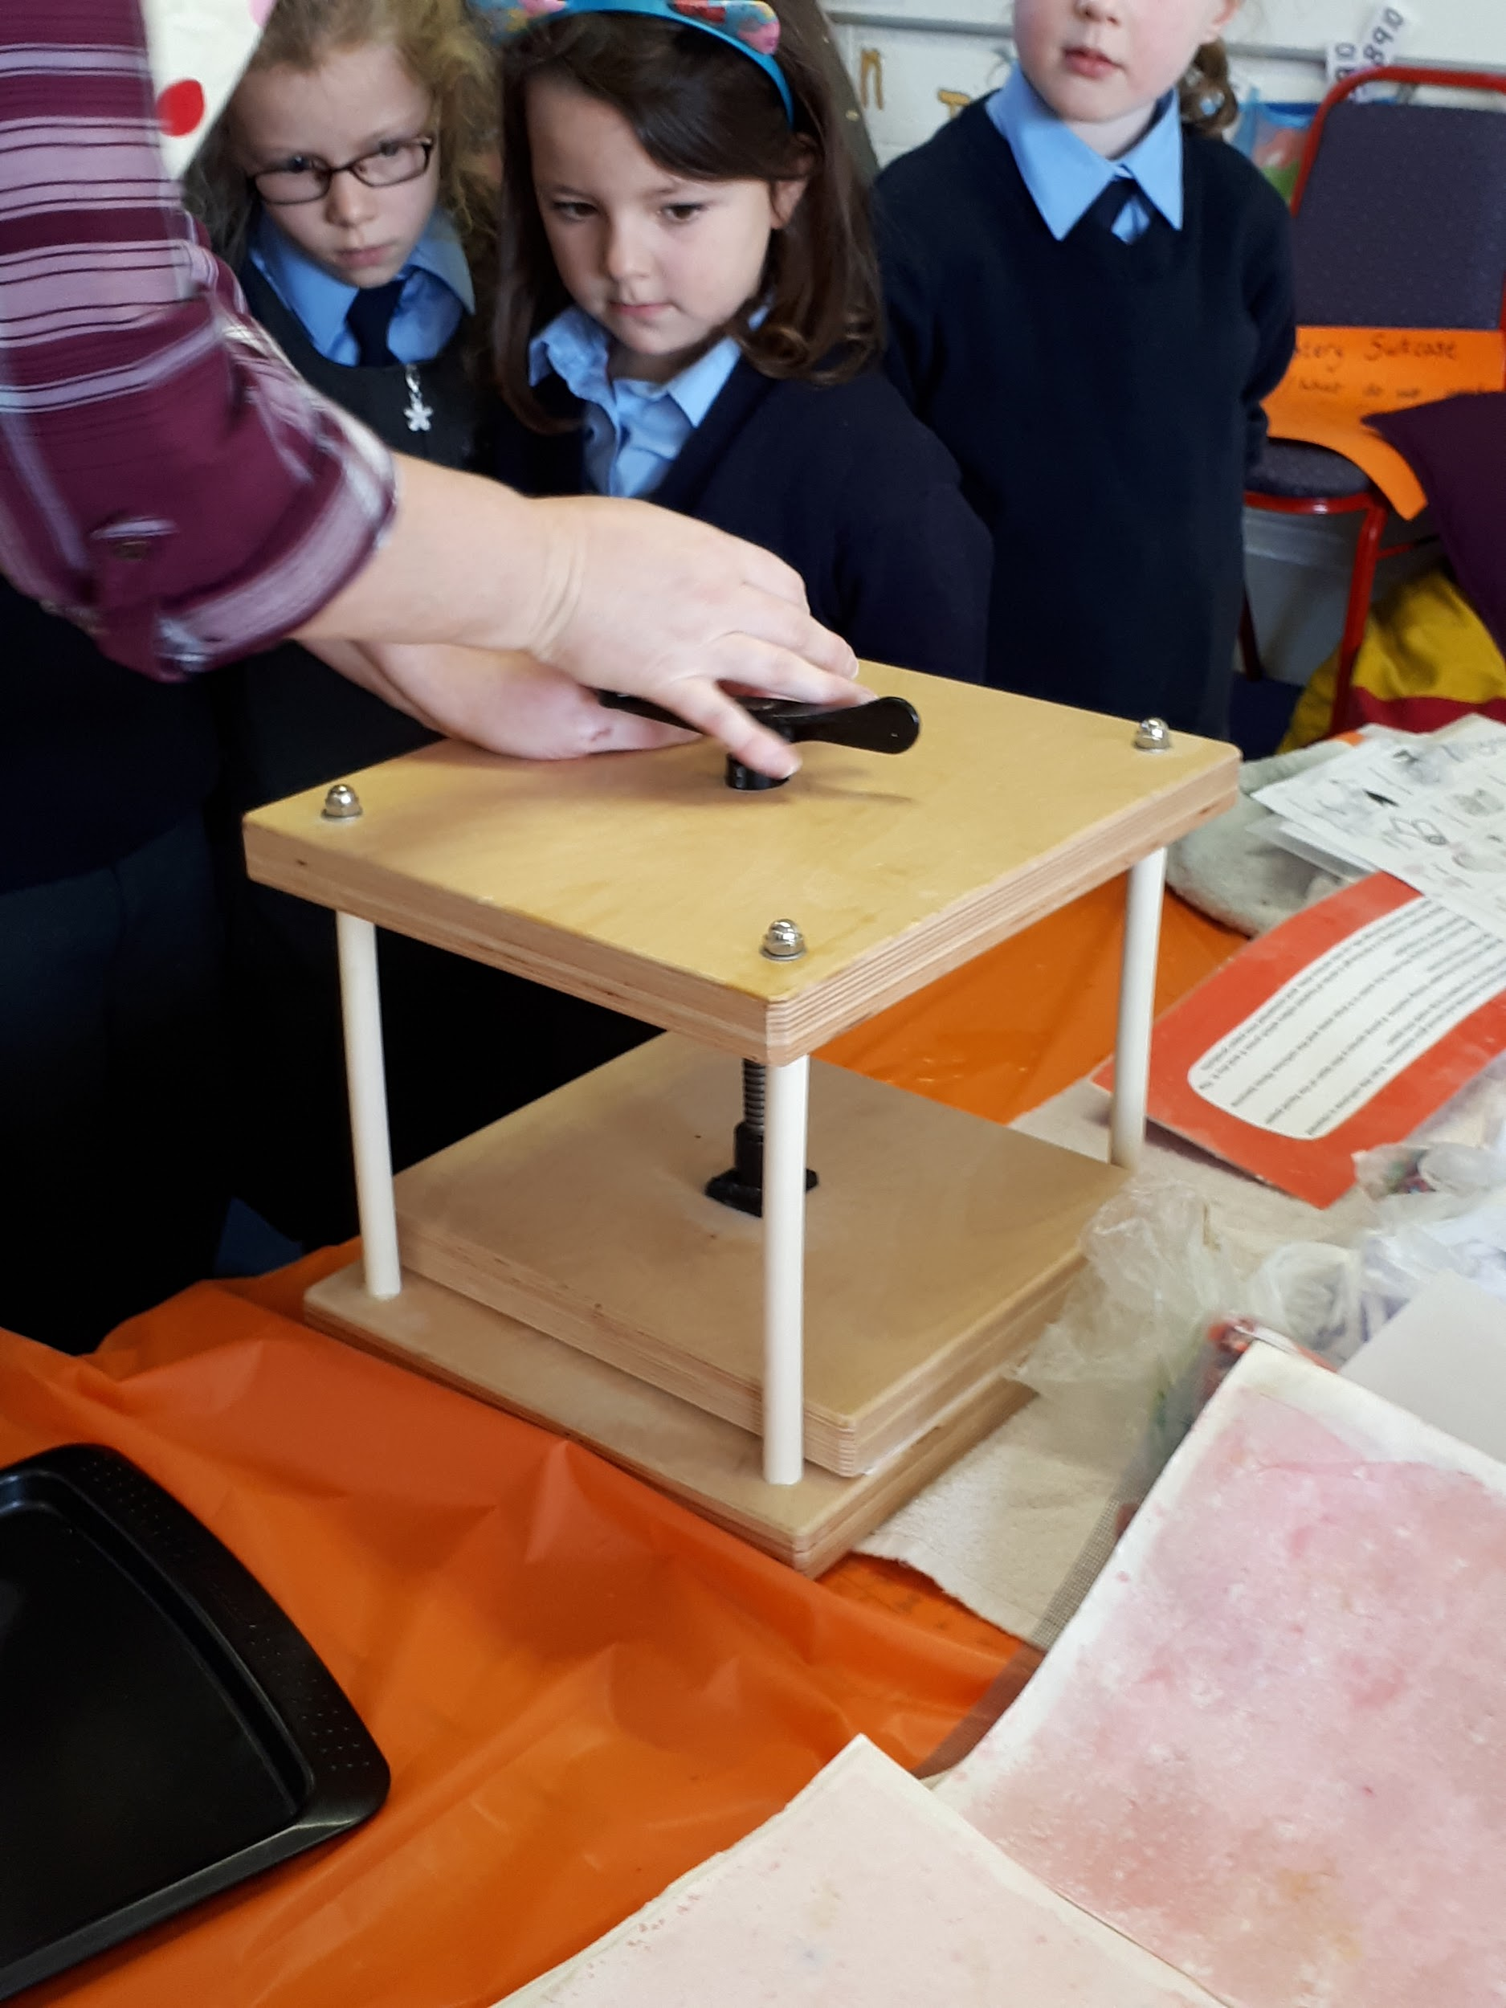
Leave the paper to dry for one week.
Continued in one week...

Slide 10
We had great fun making paper in Science Week.
We can't wait to see our paper next week and use it in our art activities!
A big THANK YOU to Angela for helping us!

